Slide 1
AMP-IS Exploration

Slide 2
Things we're changing
Num_latents: 50, 500, 5000
K: 3, 10, 30, 100
Posterior width:
"WIDE": log(scale) ~ Normal(0,1)
Mean(scale) = 1.591, stddev(scale) = 1.854
"NARROW": log(scale) ~ Uniform(-6,-1)
Mean(scale) = 0.072, stddev(scale) = 0.087
Learning rates (AMP-IS & natural RWS)
Inner_loop_iters (AMP-IS)

Slide 3
Algorithms we're trying
AMP-IS:
Regular version with some inner loop iterations, with and without ReLU in d_t calculation
No_inner_loop (with and without ReLU in d_t calculation) -- this disregards w_{t-1}
Uniform_d_t
Weight_all (saving all samples into a big mixture a la Cornuet et al. 2012 (AMIS))
Natural RWS:
Regular -- just moving average of MP-IS moments
Difference -- update with difference of sample moments and MP-IS moments
Standardised -- force sample (z) to have same mean and variance as Q
HMC
VI
MCMC
Langevin

Slide 4
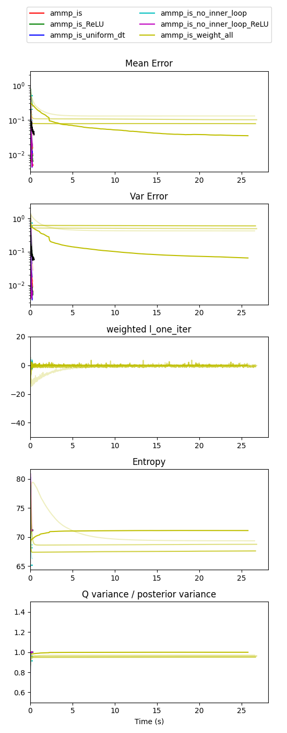
Observation 1: Ammp_is_weight_all (inspired by Cornuet et al. 2012) takes too long and isn't all that good

Slide 5
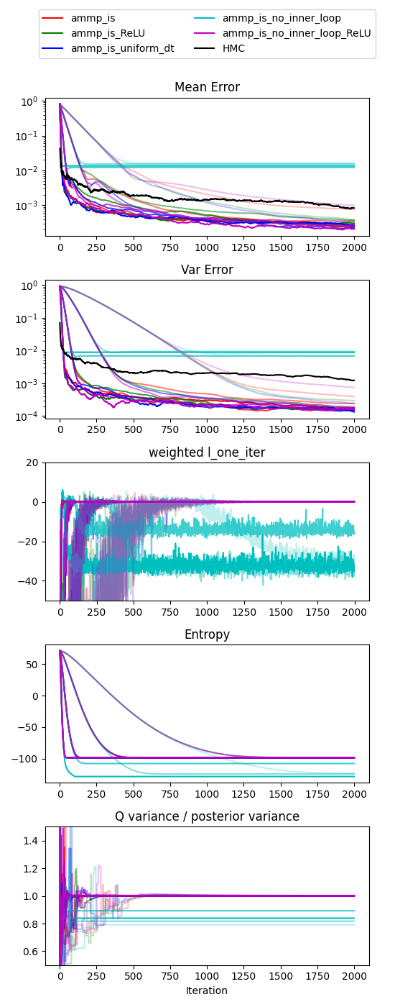
AMP-IS Learning Rates
Higher opacity means higher learning rate.
Lrs tried: 0.01, 0.03, 0.1, 0.3
Observation 2: when AMP-IS does well, higher lrs are mostly better (or at least faster)
Observation 3: no_inner_loop isn't performing very well
(Right: N=50, K=30, NARROW posterior)

Slide 6
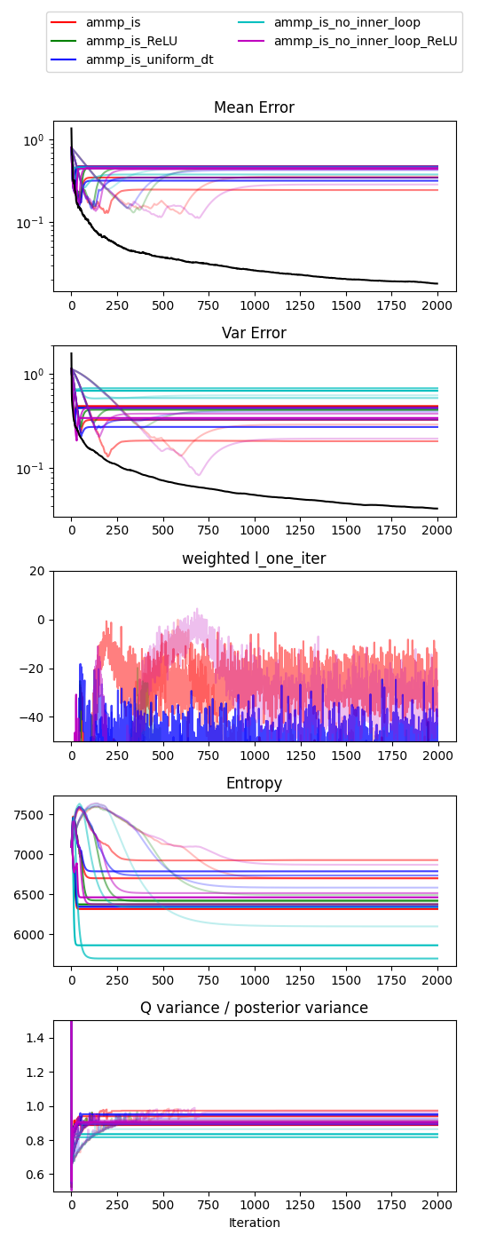
AMP-IS Learning Rates
Higher opacity means higher learning rate.
Lrs tried: 0.01, 0.03, 0.1, 0.3
Observation 4: when AMP-IS fails, its weighted l_one_iter peaks and then decreases, occuring later on for smaller lrs
(Right: N=5000, K=10, WIDE posterior)

Slide 7
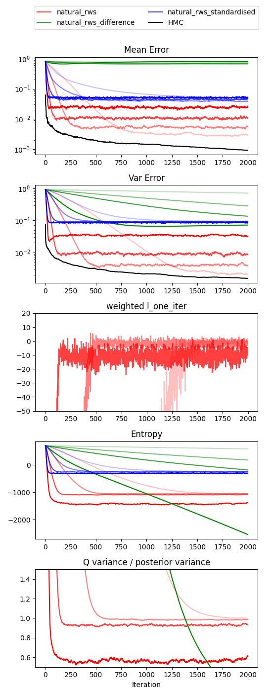
Natural RWS Learning Rates
Higher opacity means higher lr.
Lrs tried:
0.01, 0.03, 0.1, 0.3 (for regular and standardised)
0.0001, 0.0005, 0.001, 0.005 (for difference, very unstable)
Observation 5:
Regular > standardised > difference
(in terms of performance)
Observation 6: For regular natural RWS, smaller lr means better final results but more time required to reach
(Right: N=500, K=3, NARROW posterior)

Slide 8
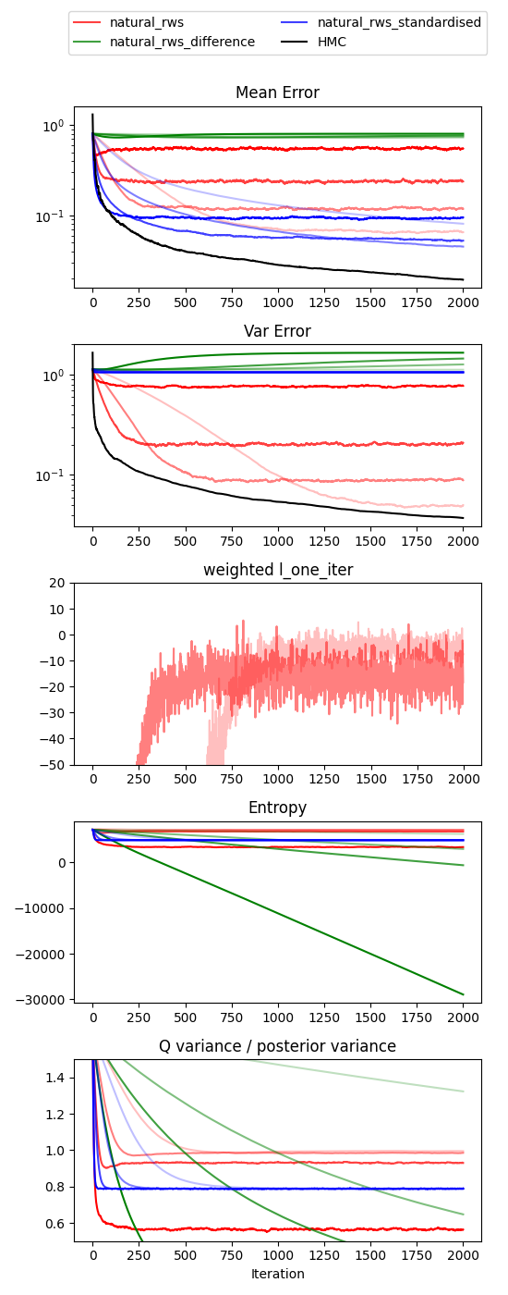
Natural RWS Learning Rates
Higher opacity means higher lr.
Lrs tried:
0.01, 0.03, 0.1, 0.3 (for regular and standardised)
0.0001, 0.0005, 0.001, 0.005 (for difference, very unstable)
Observation 7: sometimes standardised is better than regular RWS (for low K and usually only for the mean error)
Showing the same learning rate behaviour as regular RWS (though perhaps to a lesser extent).
(Right: N=5000, K=3, NARROW posterior)

Slide 9
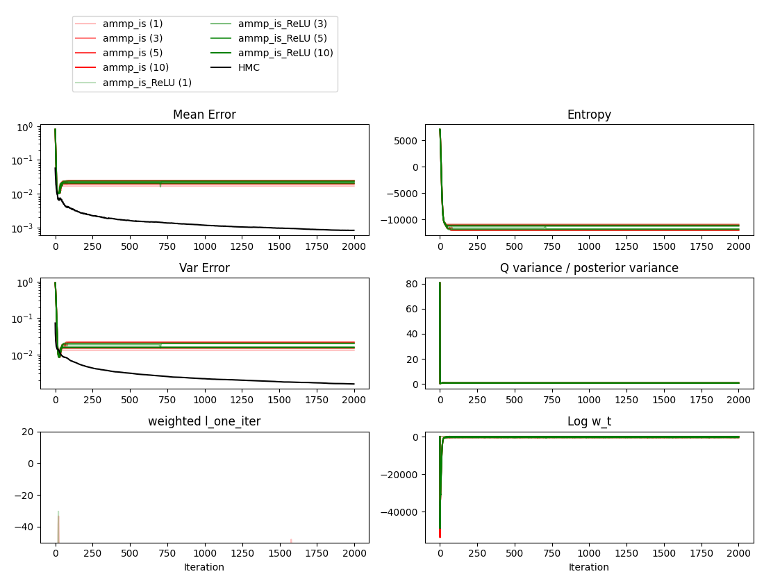
AMP-IS Inner Loop Iterations
Higher opacity means more inner loop iters (from 1, 3, 5, 10)
Tried AMP-IS with and without ReLU on entropy difference in d_t
Observation 8: Often, the number of inner loop iterations doesn't make too much of a difference: if the posterior is very easy (low N, high K) or very hard (high N, low K).
(Right: N=5000, K=10, NARROW posterior)

Slide 10
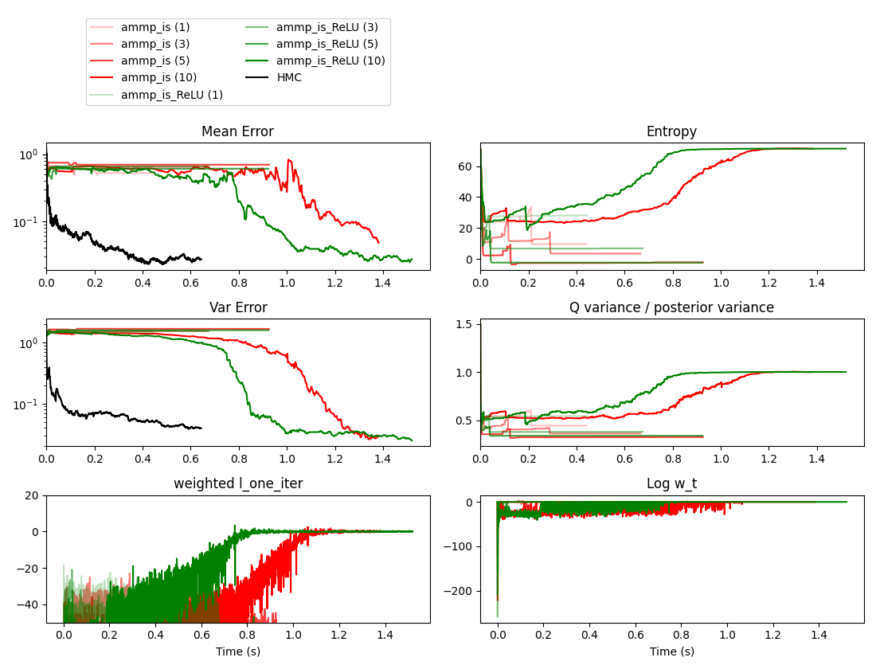
AMP-IS Inner Loop Iterations
Higher opacity means more inner loop iters (from 1, 3, 5, 10)
Observation 9: For low N, often more inner loops is helpful but expensive (takes longer than HMC)
(Right: N=50, K=3, WIDE posterior)

Slide 11
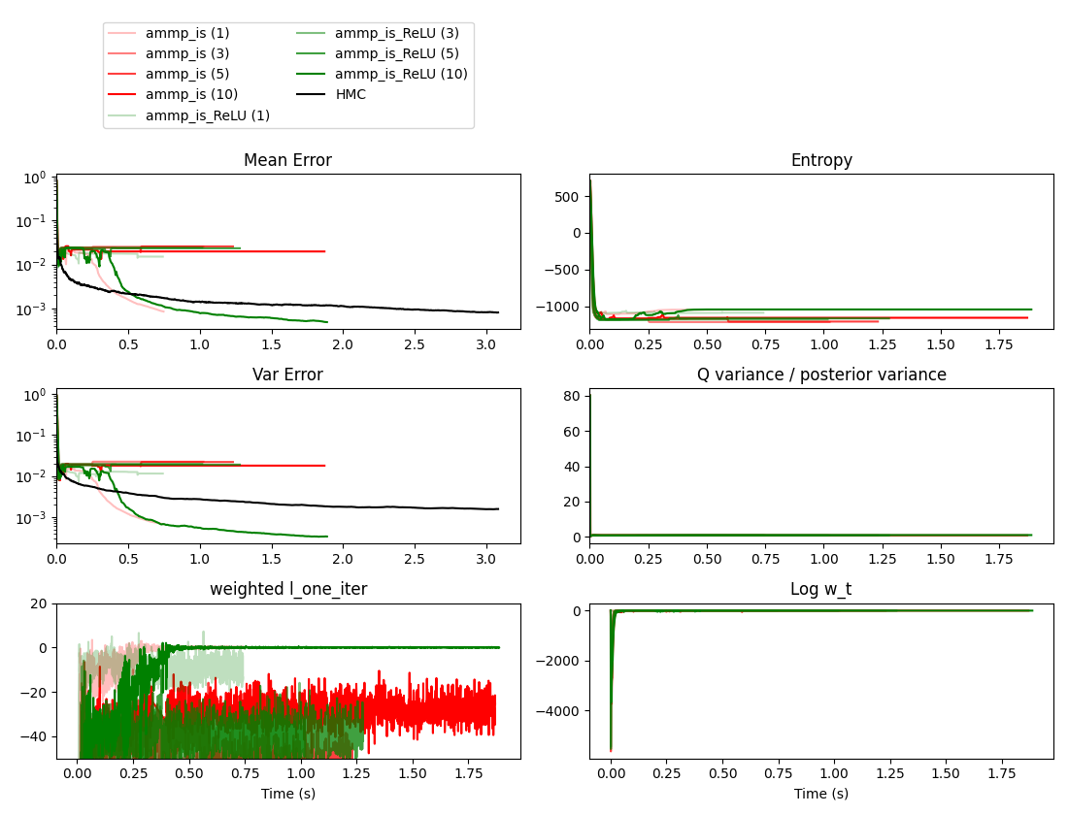
AMP-IS Inner Loop Iterations
Higher opacity means more inner loop iters (from 1, 3, 5, 10)
Observation 10: For medium-large N, it seems optimal to use 1 iteration for non-ReLU and 10 for ReLU variants.
Observation 11: Clearly the use of extra inner loops takes up more time for larger K and N.
(Right: N=500, K=10, NARROW posterior)

Slide 12
Ideal params
AMP-IS
Use high learning rate (0.4)
Use 1 inner loop to minimise cost compared to RWS
RWS:
Regular, lr = 0.01
Difference, lr = 0.01
Standardised, lr = 0.4
VI: lr = 0.05
MCMC and Lang tuned to (theoretically optimal) acceptance rates of 0.44 and 0.574 respectively.

Slide 13
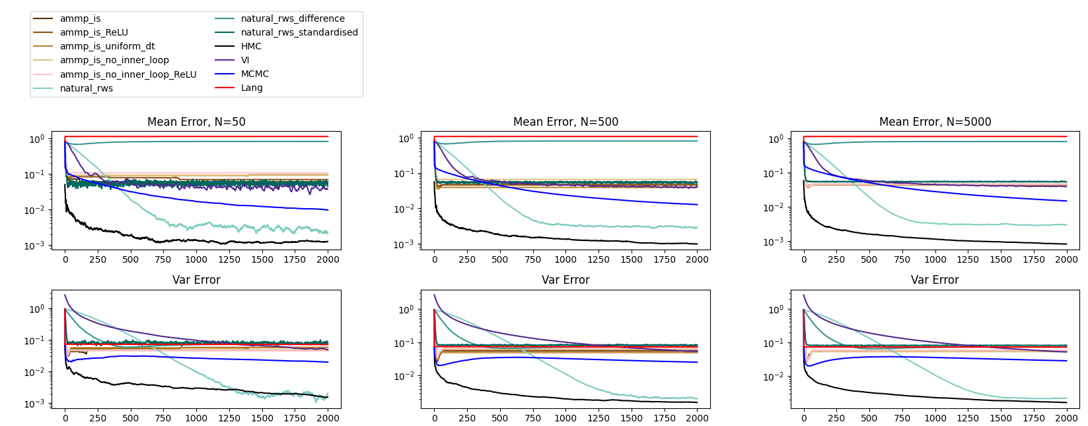
Main results, with K=10 (Below: NARROW posterior)
For low K, natural_rws is best

Slide 14
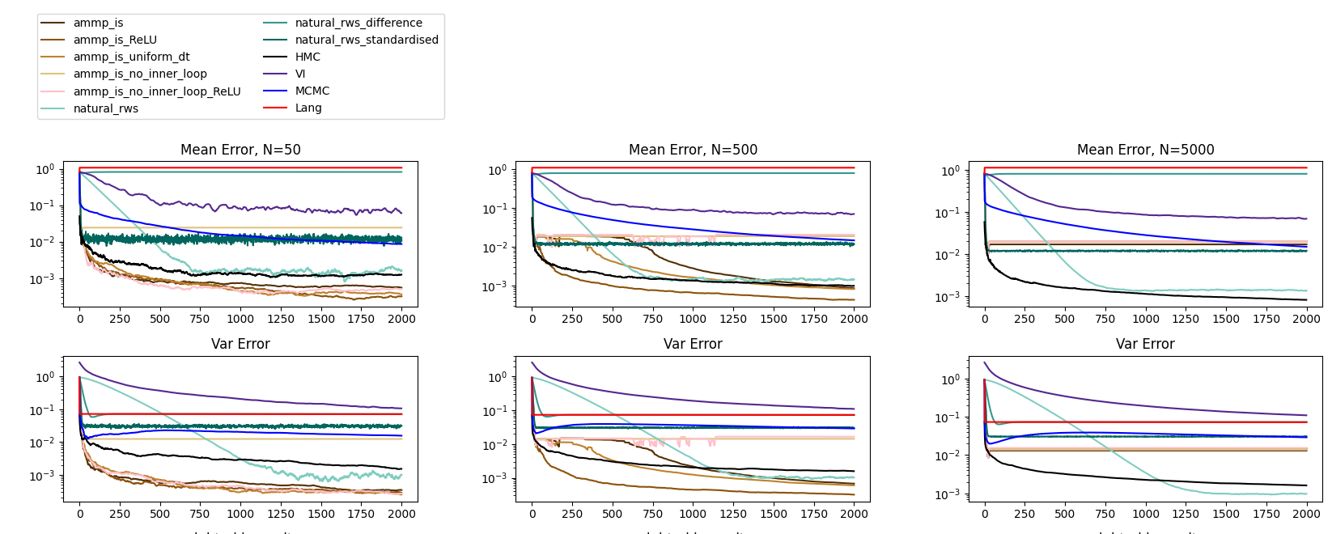
Main results, with K=10 (Below: NARROW posterior)
For lowish K, amp-is (particularly vanilla version) is best, but large N requires natural_rws
No_inner_loop is only good without ReLU

Slide 15
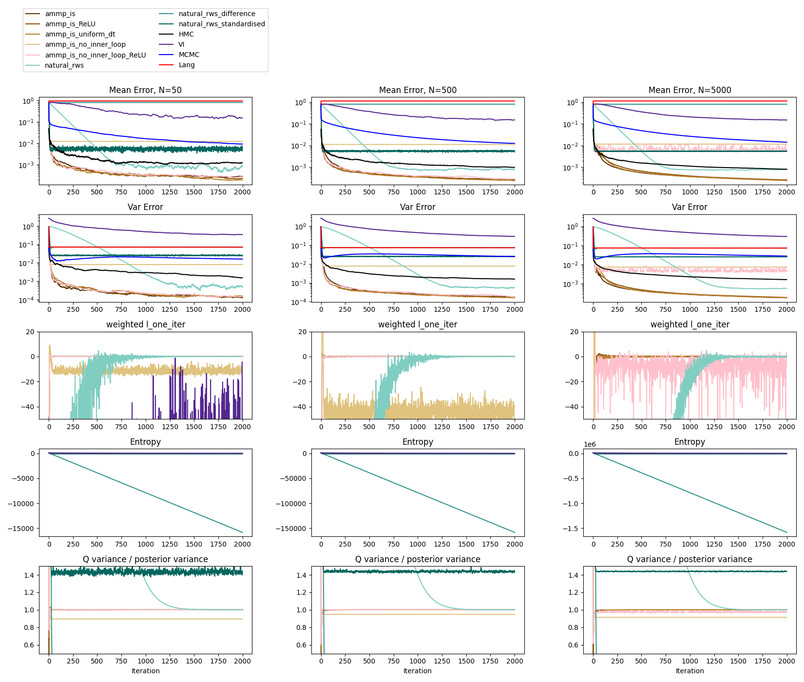
Main results, with K=30 (Below: NARROW posterior)
If K is big enough (i.e. 30) then AMP-IS is best (including uniform_dt), but natural_rws still better than HMC
No_inner_loop is only good without ReLU and for N=5000, we get weird results with ReLU

Slide 16
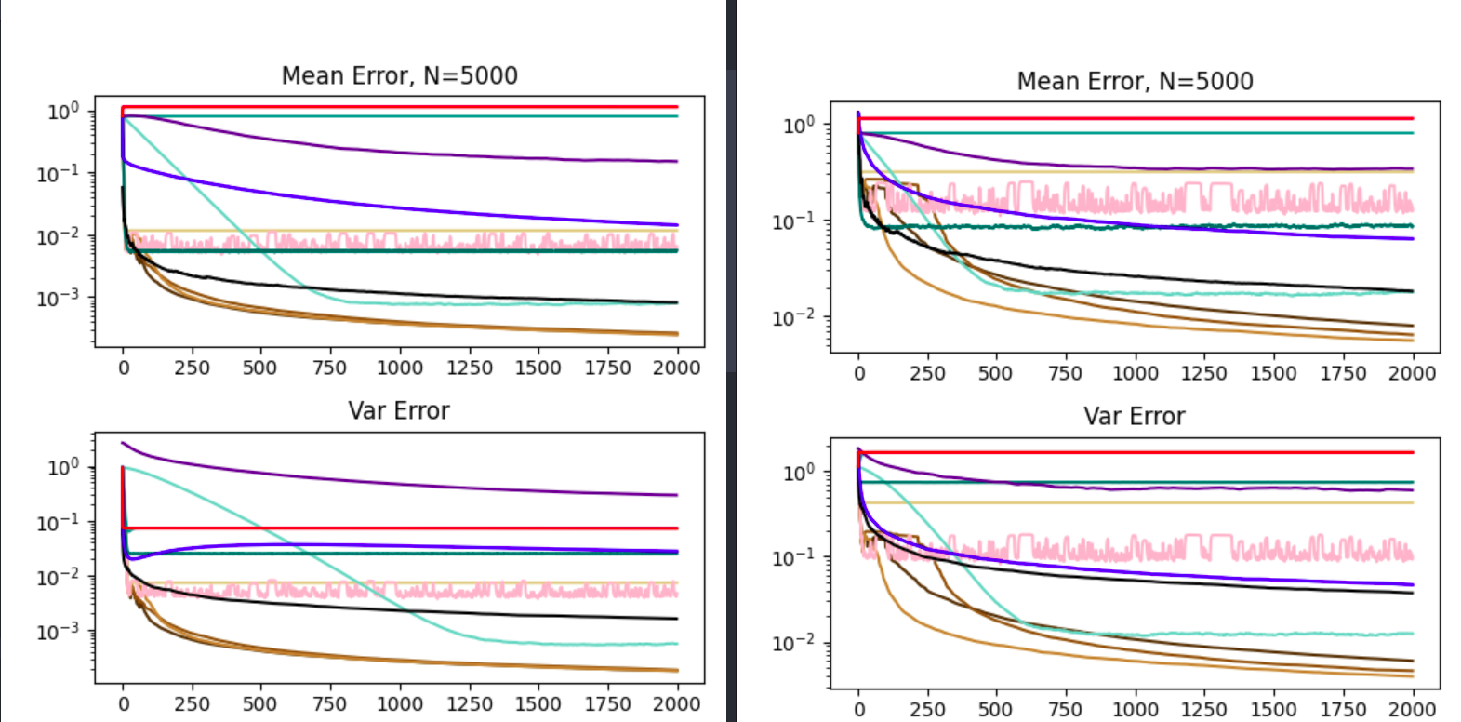
Main results, K=30 (left: NARROW, right: WIDE)
I want to say that our methods are more robust to narrow posteriors than HMC...

Slide 17
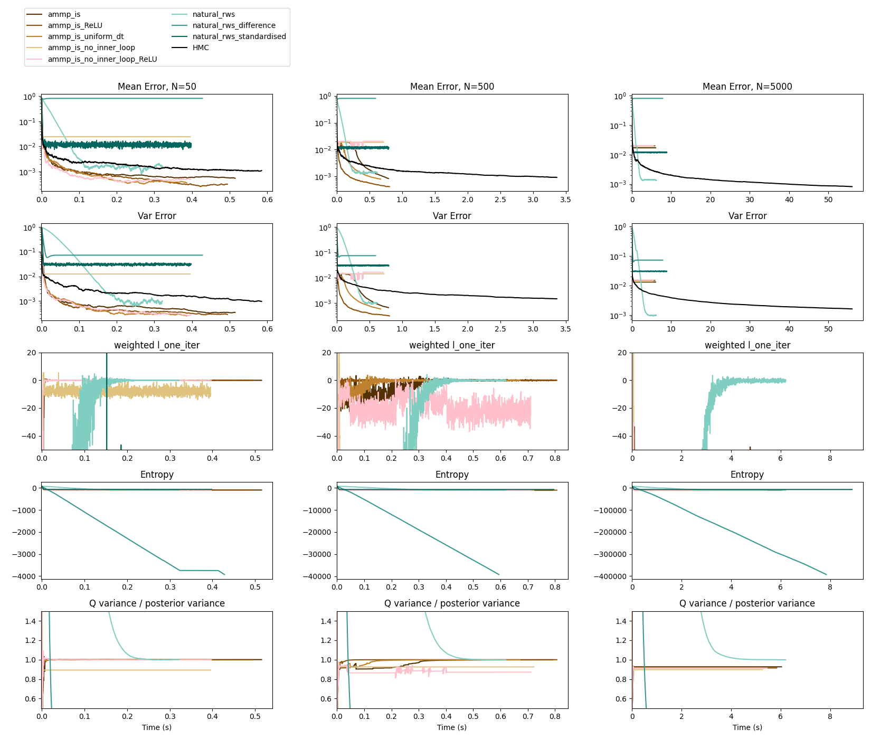
Main results: TIME (Below: K=10, NARROW posterior)
Our methods are generally faster than HMC but this improvement is made more obvious as we increase N

Slide 18
Main results: TIME (Below: K=10, NARROW posterior)
Our methods are generally faster than HMC but this improvement is made more obvious as we increase N

Slide 19
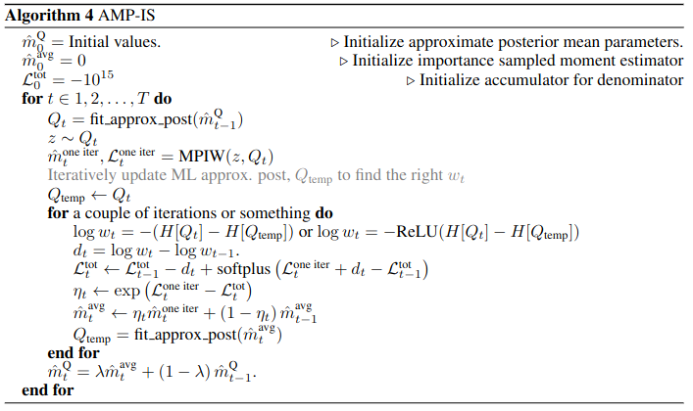
Appendix: AMP-IS (no_inner_loop == 1 inner_iter with d_t=log w_{t-1})

Slide 20
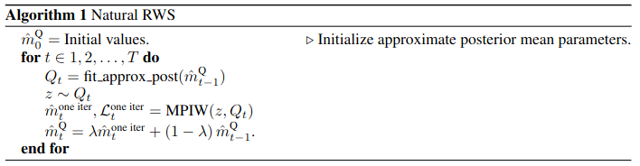
Appendix: Natural RWS

Slide 21
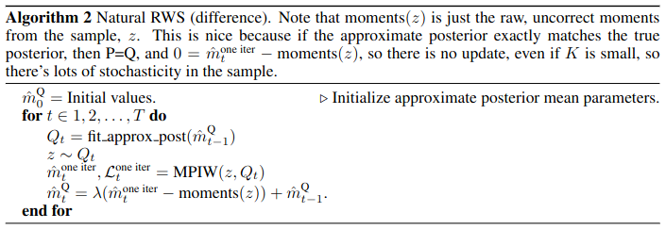
Appendix: Natural RWS (Difference)

Slide 22
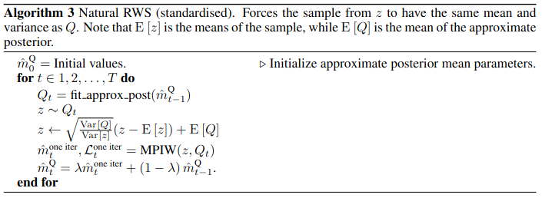
Appendix: Natural RWS (Standardised)

